Slide 1


Team 36: Mesh Walkie Talkies
Bi-Weekly Update 2 Cole Cieslewicz, Jaiah Steele, Junsu Yeo Sponsor: Giuseppe Rizzi TA: Niloofar Borzooei
Notes:
Michelle

Slide 2
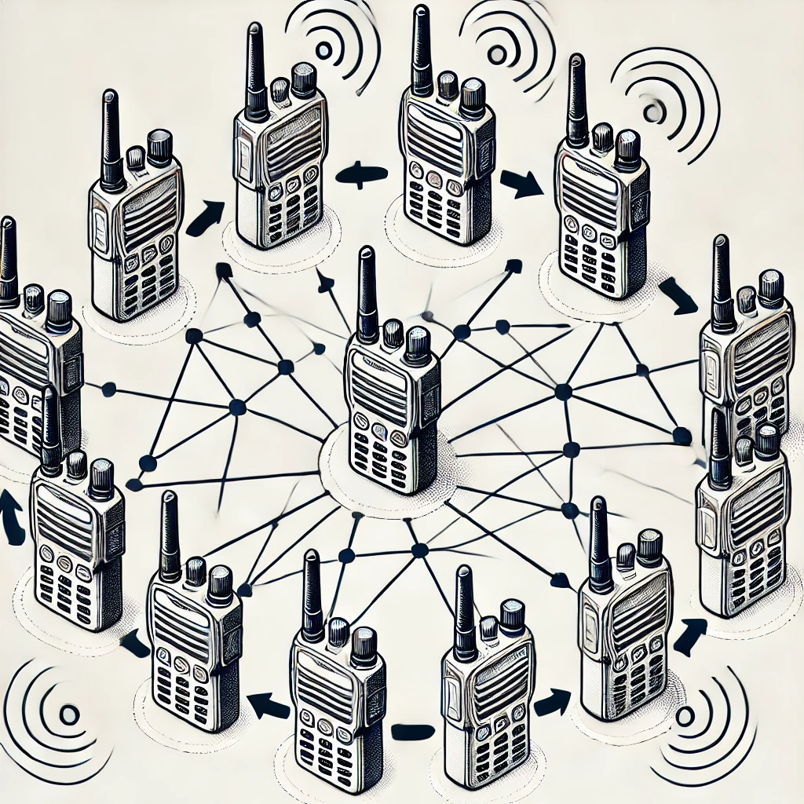
Project Summary
Conventional Walkie-Talkies:
Require close, limited communication
No network advantage
Our solution:
Mesh network to extend communication range and reliability.
Notes:
Kyle

Slide 3
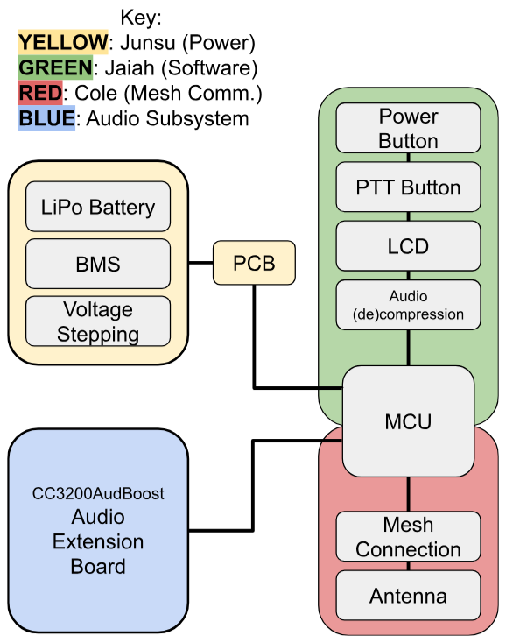
Project/Subsystem Overview
Notes:
Eric

Slide 4
Project Timeline
Subsystem Designs and Testing (completed 1/31) | Integration of Power System and Launchpad (to complete by 2/26) | Integration of mesh network and audio (to complete by 3/5) | 3D printing walkie talkie case (to complete by 3/12) | Enclosing device and System Test (to complete by 4/02) | Validation (to complete by 4/16) | Demo and Report (to complete by 4/28)
Key:
Green = Completed
Yellow = In Progress
White = Have not started
Notes:
Eric

Slide 5
Push-To-Talk/Audio Functionality
Jaiah
Accomplishments since last update 8 hrs of effort | Ongoing progress/problems and plans until the next presentation
Merging RX and TX functionality into a single firmware for both LaunchPads is in progress On-going integration of LCD Push-To-Talk with RF transmission Was able to verify RF transmission with on board GPIO’s (Green ON for transmitting, toggle for idle/default, and red ON for receiving) Debugging unexpected behaviors where messages may not update as expected. | Debug LCD timing to ensure accurate status updates during transmission and reception. Verify that packets are properly received and that reception triggers LCD updates. Test in real-time scenarios with both LaunchPads communicating dynamically.

Slide 6
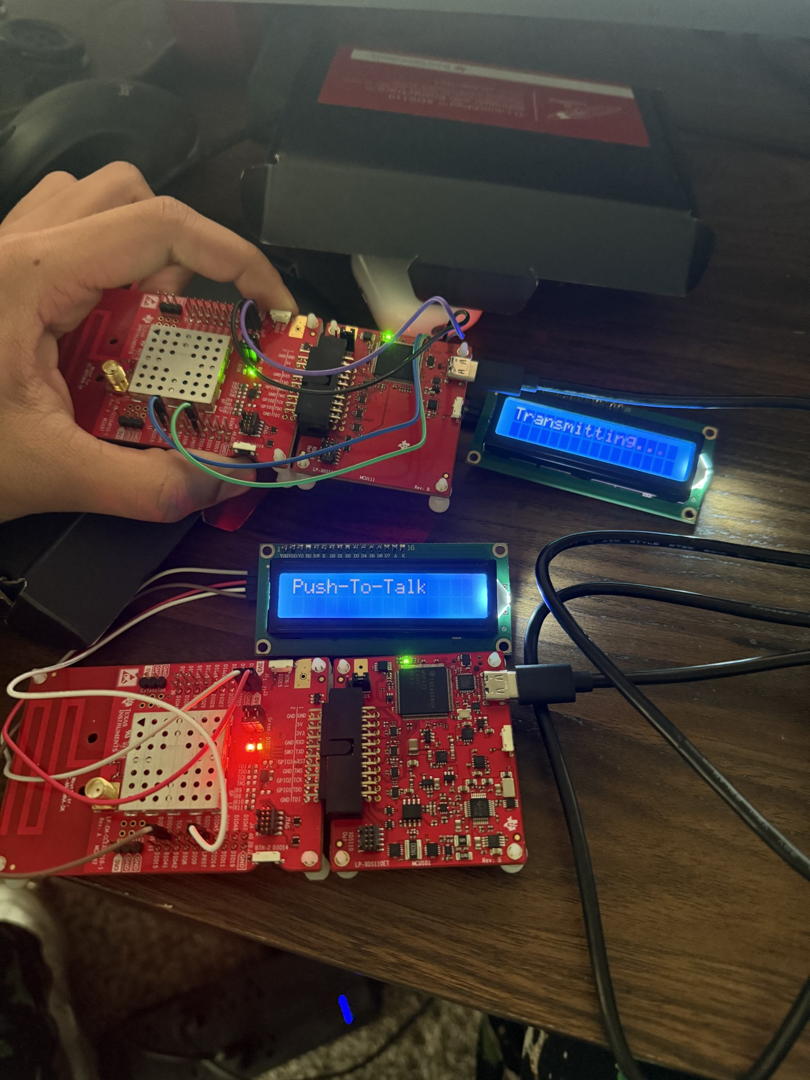
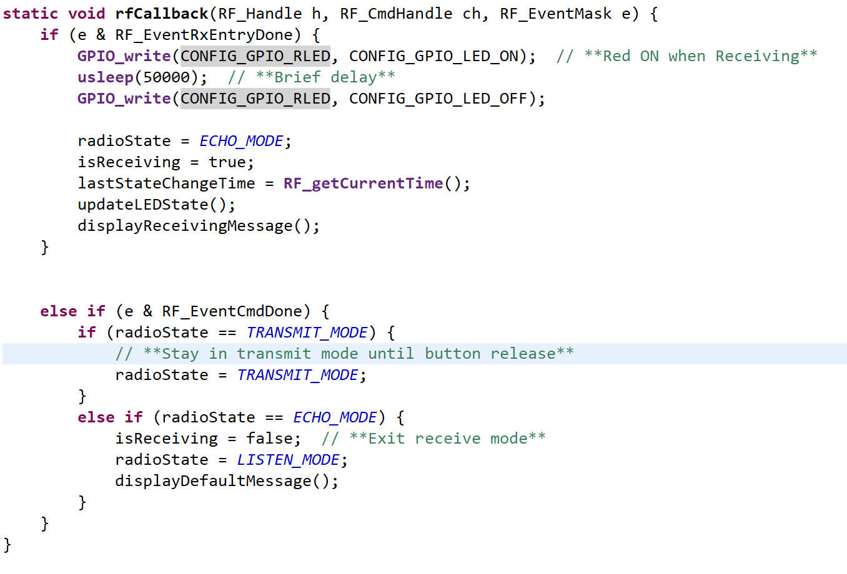
Push-To-Talk/Audio Functionality
Jaiah
Transmission Packets Are Being Sent
When the push-to-talk (PTT) button is pressed, the LaunchPad successfully sends an RF packet.
The transmission function is triggered properly.
Packets contain the necessary information, including sender ID and transmission status.
LCD displays "Transmitting..." as expected.
Reception Handling Needs Debugging
The receiving LaunchPad does not always update its LCD when a packet is received.
Reception code executes inconsistently—sometimes packets are detected, other times they are missed.
When reception does work, the LCD should display "Receiving"
Made E2E forum post for challenges

Slide 7
Mesh Connection Subsystem
Cole Cieslewicz
Accomplishments since last update 6 hrs of effort | Ongoing progress/problems and plans until the next presentation
Recoded the part of my program that transitions between Rx and Tx to make it function w/out resetting device Begun testing interaction between Launchpad and AudBoost to see how to packetize audio signal Tested antennas and determined more board manipulation will be necessary to make them work Assisted Jaiah with his firmware integration for Rx/Tx | Assemble packets of audio small enough for transmission (Jaiah to help) Replace keyboard input with audio packets/files in Tx firmware Remove UART functionality in order to cut out need for external communication prompting device

Slide 8
Mesh Connection Functionality
Cole Cieslewicz
Transmission Packets Are Being Sent
When the push-to-talk (PTT) button is pressed, the LaunchPad successfully sends an RF packet.
The transmission function is triggered properly.
Packets contain the necessary information, including sender ID and transmission status.
LCD displays "Transmitting..." as expected.

Slide 9
Power System
Junsu Yeo
Accomplishments since last update 8 hrs of effort | Ongoing progress/problems and plans until the next presentation
New PCB and Components arrived. Completed assembly of new PCB. Tested the output voltage of the converters is 5V and 3.3V. The new PCB successfully powered the launchpad. | Finish design of final PCB adding a 20 pin board to board connector and the battery charger.

Slide 10
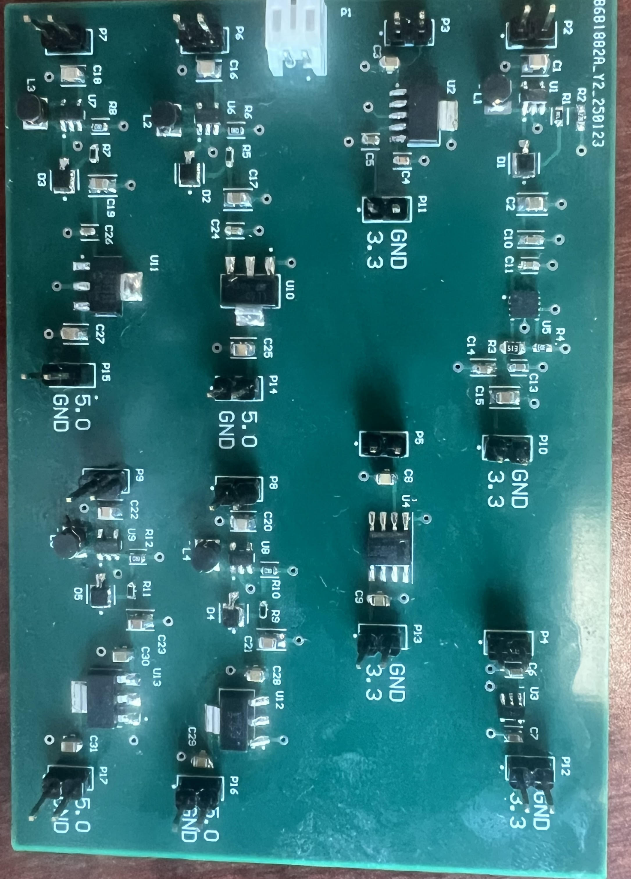
Power System
Junsu Yeo
Components | Expected Output [V] | Measured Output [V]
MIC2288Yd5-TR TPS79601DRBR | 3.3 | 3.2951
TPS79633DCQR | 3.3 | 3.3112
AP7366-33W5-7 | 3.3 | 3.3101
AP7362-33SP-13 | 3.3 | 3.2643
MIC2288Yd5-TR LDL1117S50R | 5.0 | 4.9844
MIC2288Yd5-TR MCP1826S-5002E/DB | 5.0 | 4.9671
MIC2288Yd5-TR LM1117MPX-5.0/NOPB | 5.0 | 2.5250
MIC2288Yd5-TR NCP1117ST50T3G | 5.0 | 4.9887

Slide 11
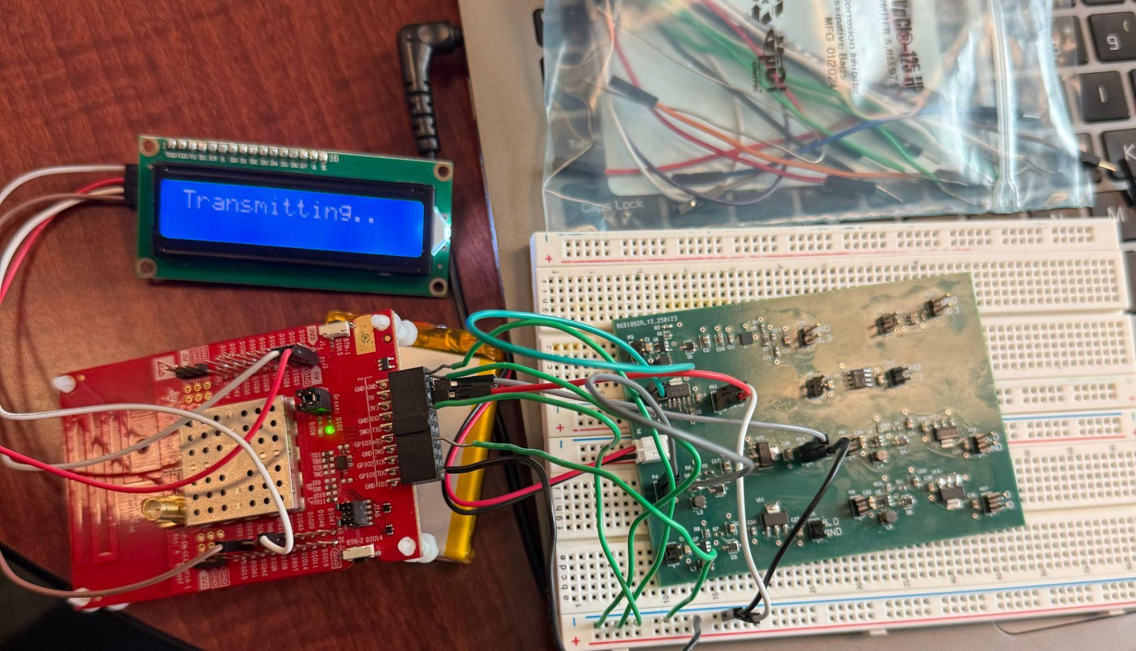
Power System
Junsu Yeo

Slide 12
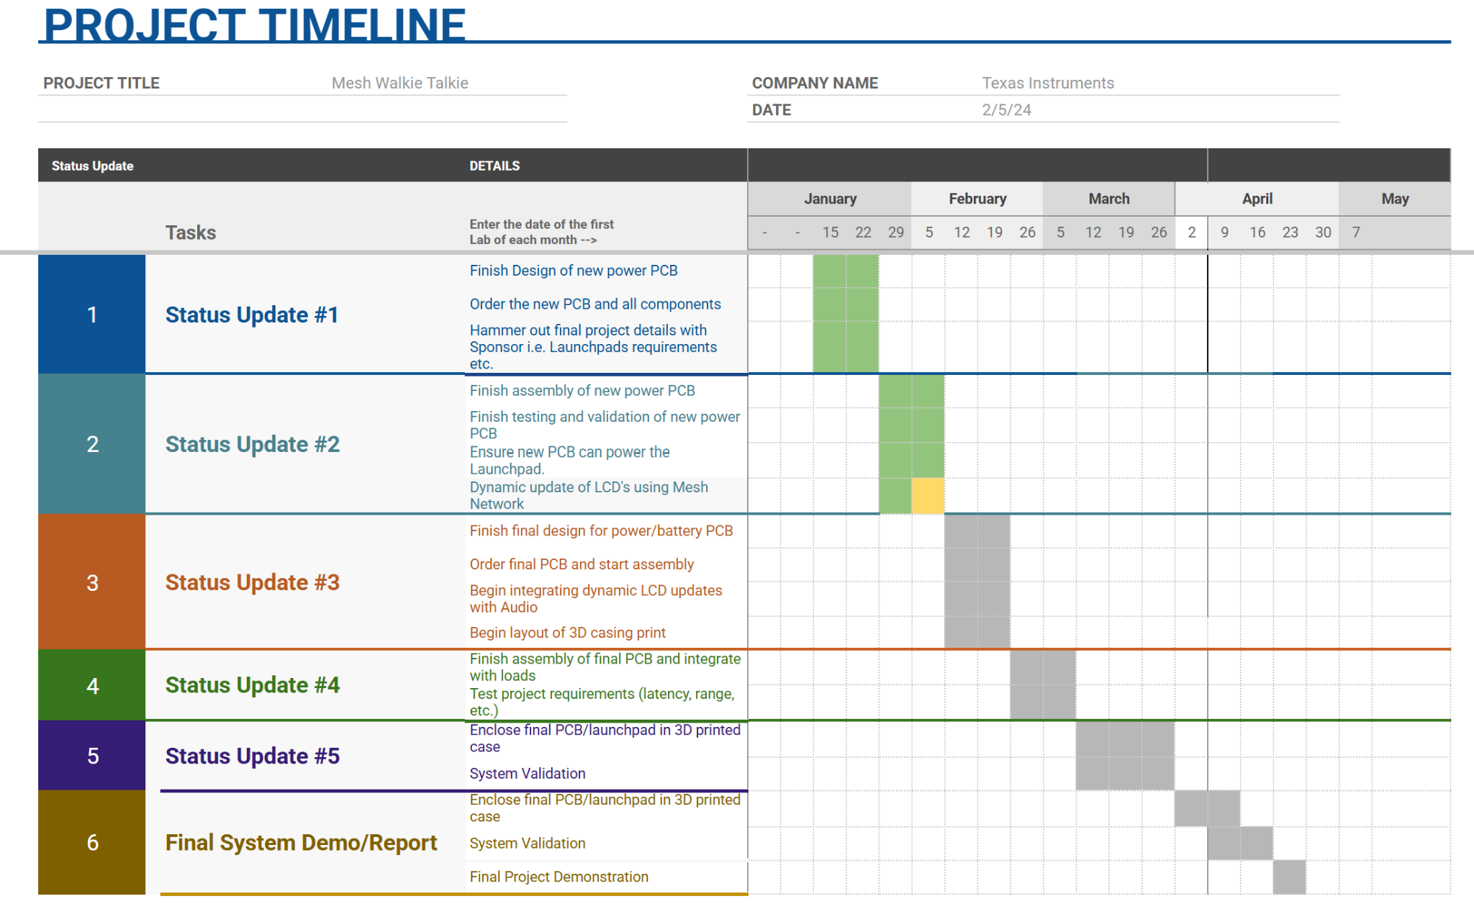
Execution Plan
Notes:
Michelle

Slide 13
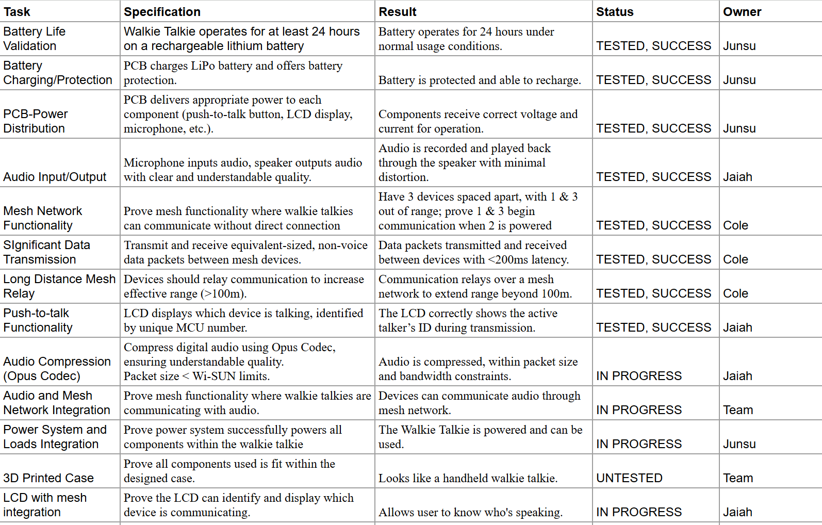
Validation Table

Slide 14
Thank you!

